Slide 1
Explanation
<text>
Editable
Text
Button
Icon (can have text next to it if needed)
Image for reference:
(Game) Super Mario Maker 2
(Website) Brilliant
Background

Slide 2
Opening (if not logged in)
<Game Title>
<username>
<password>
Drop-down to choose admin/student since our school also does that for some reason?
Log In

Slide 3



Choosing Character (if not selected before)
Choose your character
<name 1>
<name 2>
<name 3>

Slide 4
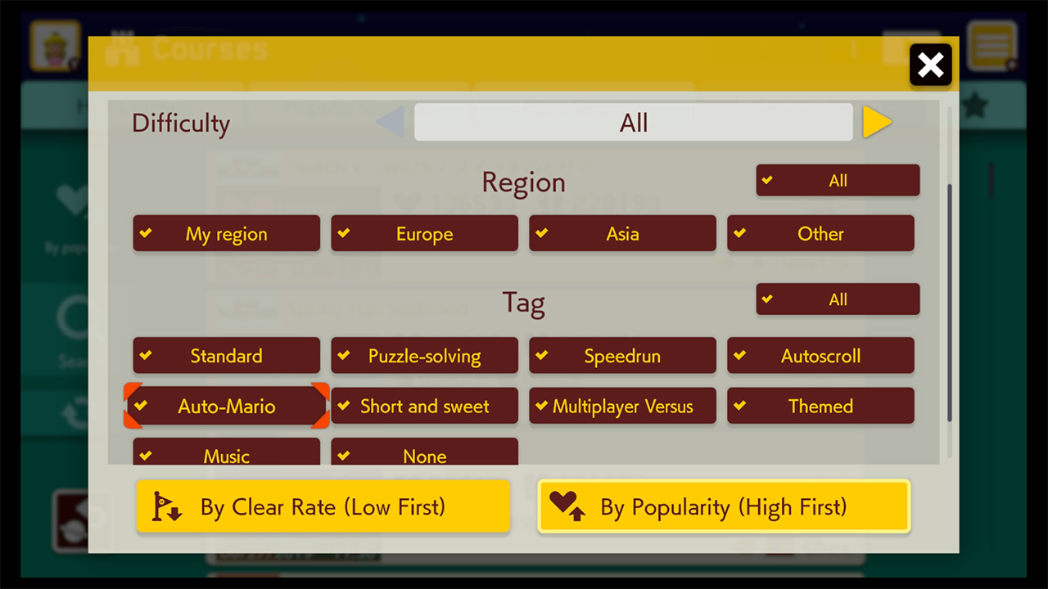
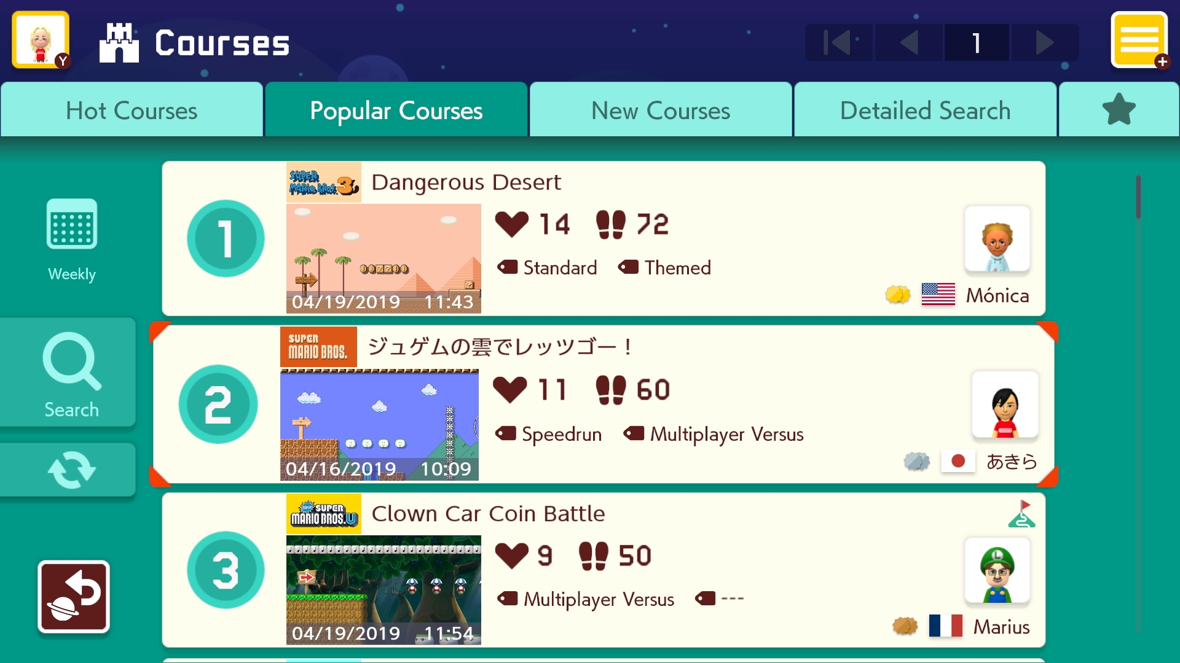
World / Section Selection
Go to Create
Choose something to play!
Settings
<
Custom
World 1
World 2
World 3
>
<World Description>
Section 1
By: <name>
Clear % / Some stats
Section 1 Description
<- Scrollbar ->
Section 2
By: <name>
Clear % / Some stats
Dropdown or Popup For Sort/Filter
Section 2 Description
Section 3
By: <name>
Clear % / Some stats
Section 3 Description
Section 4
By: <name>
Clear % / Some stats
Section 4 Description
Section 5
By: <name>
Clear % / Some stats
Section 5 Description
Section 6
By: <name>
Clear % / Some stats
Section 6 Description

Slide 5
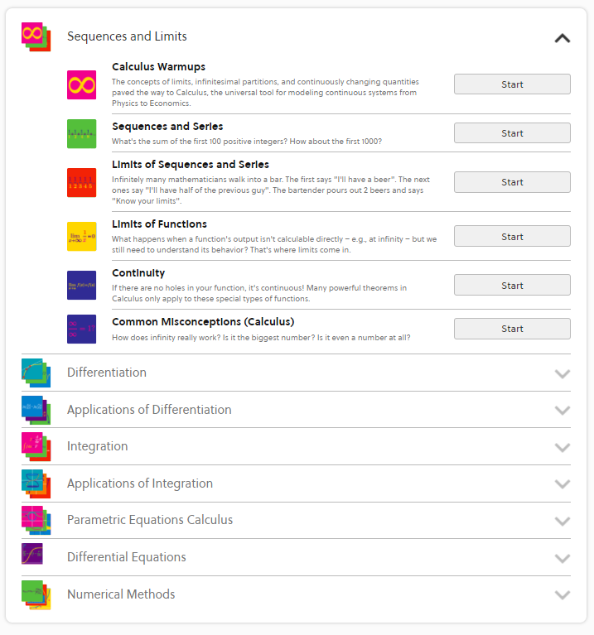
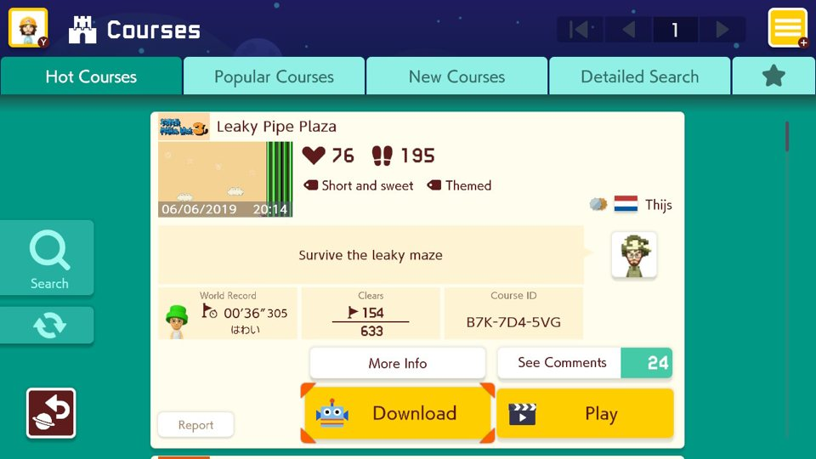
After pressing a Section
Go to Create
Choose something to play!
Settings
<
Custom
World 1
World 2
World 3
>
<World Description>
Section 1
<description and stats stuff>
<- Scrollbar ->
Dropdown or Popup For Sort/Filter
Leaderboard
Play
Delete
Section 2
By: <name>
Clear % / Some stats
(not for Custom World)
Section 2 Description
You sure?
Confirmation appears after Delete is pressed
Delete only visible for admins and owner of section
Yes

Slide 6
Viewing Leaderboard
Go to Create
Choose something to play!
Settings
<
Custom
World 1
World 2
World 3
>
<leaderboard>
<- Scrollbar ->
Leaderboard
(Closes the leaderboard)

Slide 7
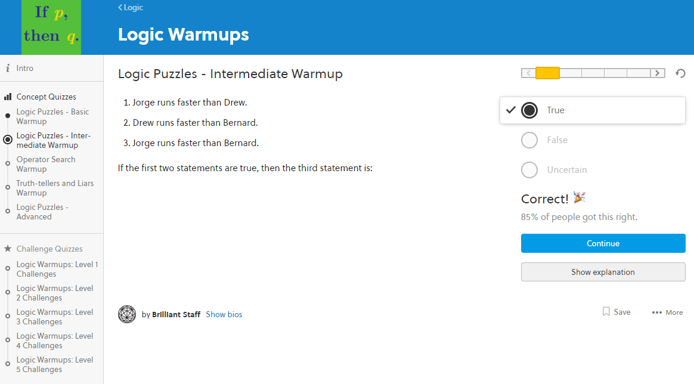
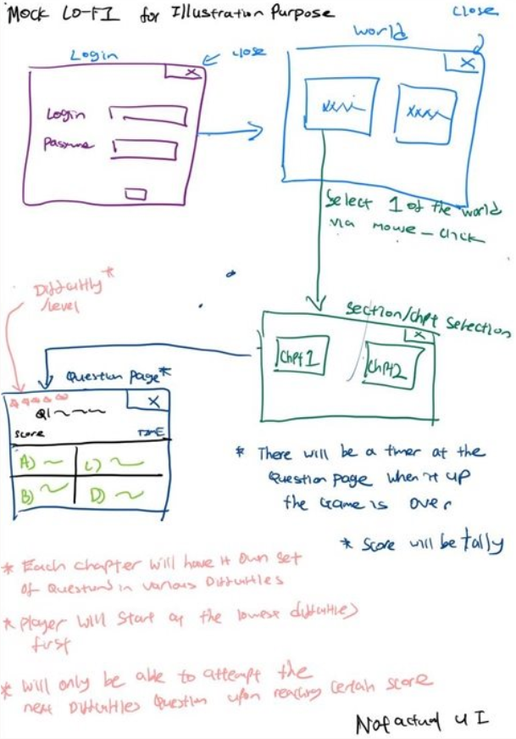
Difficulty options:
Increases if 2x in a row correct, decreases if 2x in a row wrong
Based on score
Playing Levels
<World Name> - <Section Name>
Back (World
Selection)
Settings
By: NTU / <name>
Score: X
Question No. X out of Y
Timer: X
Question Text
<Explanation to answer appears here after submission>
Answer 1
Answer 2
Answer 3
Answer 4
% got correct
Submit (Changes to Continue when submitted)
(If got time) Find some way to include images / diagrams for the question
(Maybe) The correct % only shows when user answers correctly

Slide 8
Finished a Section
<World Name> - <Section Name>
Back (World
Selection)
Settings
By: NTU / <name>
Final Score: X
What else to include here???
Time Taken: X

Slide 9





(Maybe) Prompt about unsaved changes
Create (Difficulty disabled)
Confirmation appears after they press
Go to Play
Create your own section!
Settings
Enter name:
You sure?
Yes
<question text>
Description:
<question text>
<error message>
Timer (Leave 0 for no timer)
<question text>
X minutes
Difficulty:
<answer text>
<note about difficulty>
<answer text>
Upload to Official:
You sure?
Yes
Confirmation appears after they press
Dropdown for Official World
Official stuff only appears to Admin
Save
Publish
You sure?
Yes
Confirmation replaces Publish button after they press Publish (Redirects to Custom World screen)

Slide 10
If difficulty is enabled, notify them about how it works and that they will need to have X number of questions for each difficulty
The number of questions played will be the minimum number out of the difficulties
e.g., 5 easy, 4 medium, 6 hard -> 4 questions played
Rest will be random
(Maybe) Prompt about unsaved changes
Create (Difficulty enabled)
Confirmation appears after they press
Go to Play
Create your own section!
Settings
Enter name:
You sure?
0
Easy
2
Medium
1
Hard
Yes
[Medium] <question text>
Description:
[Hard] <question text>
Sort from Easy to Hard
<error message>
Timer (Leave 0 for no timer)
<question text>
X minutes
Difficulty:
<answer text>
<note about difficulty>
<answer text>
Upload to Official:
You sure?
Easy
Medium
Hard
Yes
Confirmation appears after they press
Dropdown for Official World
Official stuff only appears to Admin
Save
Publish
You sure?
Yes
Confirmation replaces Publish button after they press Publish (Redirects to Custom World screen)

Slide 11
(Maybe) Prompt about unsaved changes
Create World
Go to Play
Create an official world!
Settings

